Slide 1
Portafolio
Creative Process
By Cinthya Cabanzo

Slide 2
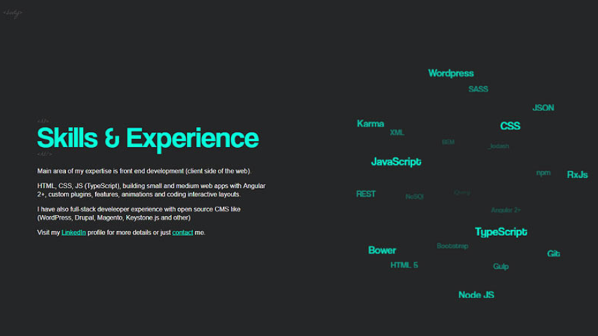


Slide 3
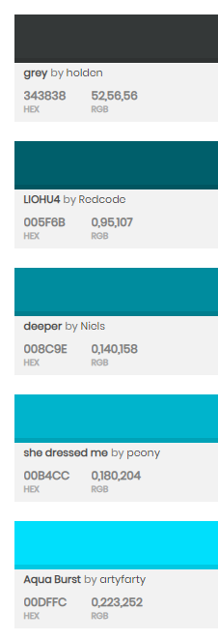
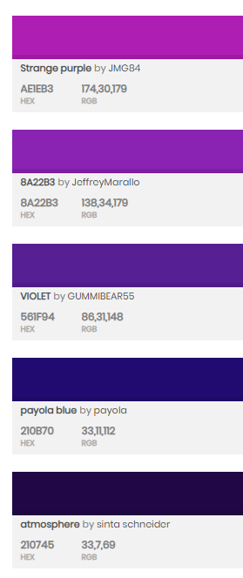
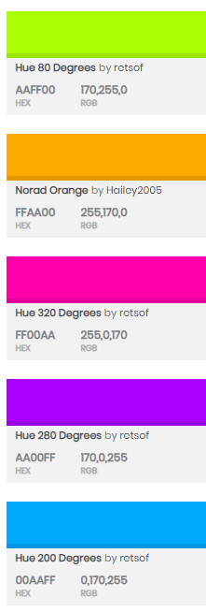
Paletas

Slide 4
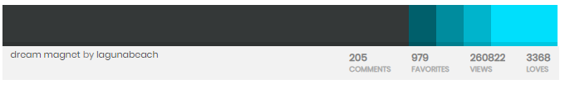
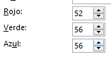
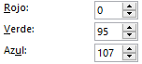
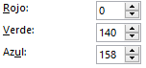
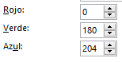
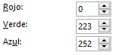
Paleta
#343838
#005F6B
#008C9E
#00B4CC
#00E9FC

Slide 5
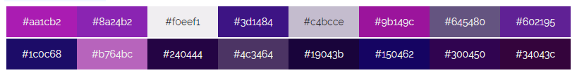
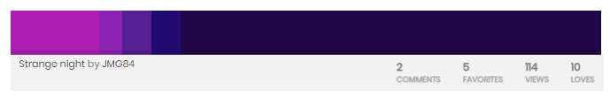
Paleta
Notes:
#aa1cb2
#8a24b2
#f0eef1
#3d1484
#c4bcce
#9b149c
#645480
#602195
#1c0c68
#b764bc
#240444
#4c3464
#19043b
#150462
#300450
#34043c

Slide 6
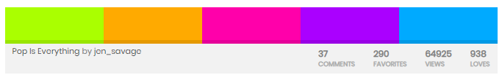
Paleta Modo Nocturno

Slide 7

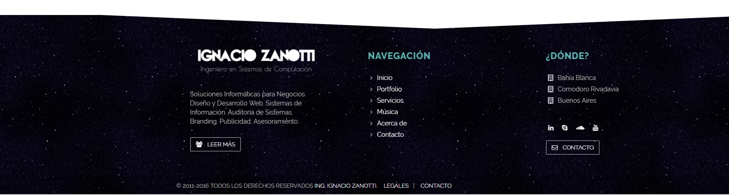
Footer
Notes:
https://www.w3schools.com/css/css3_buttons.asp
<style>
.button2:hover {
box-shadow: 0 8px 16px 0 rgba(0,0,0,0.24),0 17px 50px 0 rgba(0,0,0,0.19);
}
</style>

Slide 8
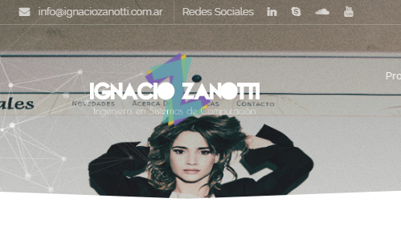
Banner Dinamico
Notes:
http://www.ignaciozanotti.com.ar/tributoweb

Slide 9

Iconos
Notes:
<div>Icons made by <a href="https://www.freepik.com/?__hstc=57440181.dd2f7117b66840b57fe64a259c87dc7b.1561213190986.1561213190986.1561213190986.1&__hssc=57440181.3.1561213190987&__hsfp=4222521352" title="Freepik">Freepik</a> from <a href="https://www.flaticon.com/" title="Flaticon">www.flaticon.com</a> is licensed by <a href="http://creativecommons.org/licenses/by/3.0/" title="Creative Commons BY 3.0" target="_blank">CC 3.0 BY</a></div>

Slide 10
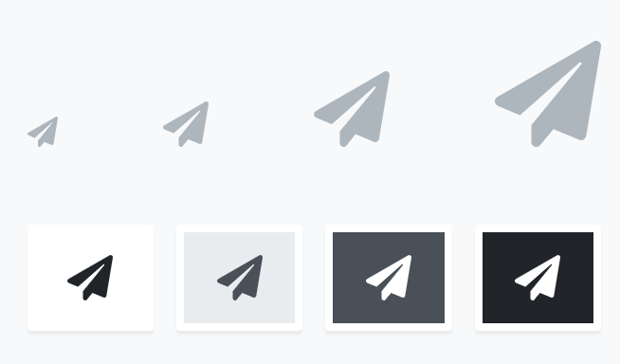
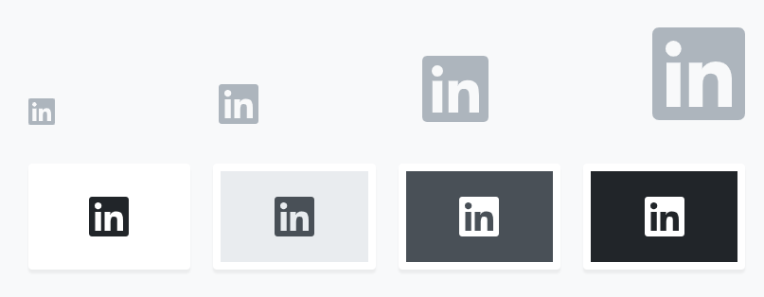
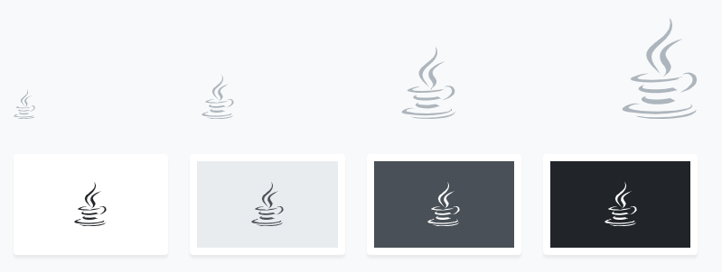
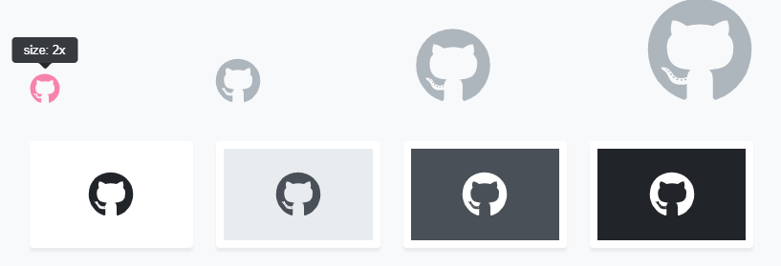
Iconos
https://fontawesome.com/
<i class="fab fa-github"></i>
<i class="fab fa-java"></i>
<i class="fab fa-linkedin"></i>
<i class="fas fa-paper-plane"></i>
<i class="fab fa-html5"></i>
<i class="fab fa-css3-alt"></i>
<i class="fas fa-copy"></i>
<i class="fas fa-lightbulb"></i>

Slide 11
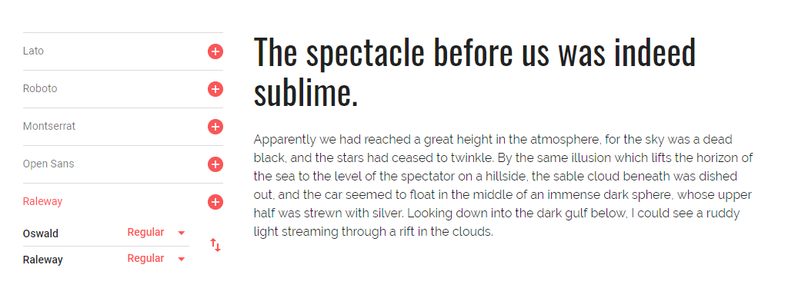
Fuentes
Notes:
https://developers.google.com/fonts/docs/getting_started
<style> @import url('https://fonts.googleapis.com/css?family=Oswald:200,300,400,500,600,700|Raleway:100,100i,200,200i,300,300i,400,400i,500,500i,600,600i,700,700i,800,800i,900,900i&display=swap'); </style>
<link href="https://fonts.googleapis.com/css?family=Oswald:200,300,400,500,600,700|Raleway:100,100i,200,200i,300,300i,400,400i,500,500i,600,600i,700,700i,800,800i,900,900i&display=swap" rel="stylesheet">
font-family: 'Oswald', sans-serif;
font-family: 'Raleway', sans-serif;

Slide 12
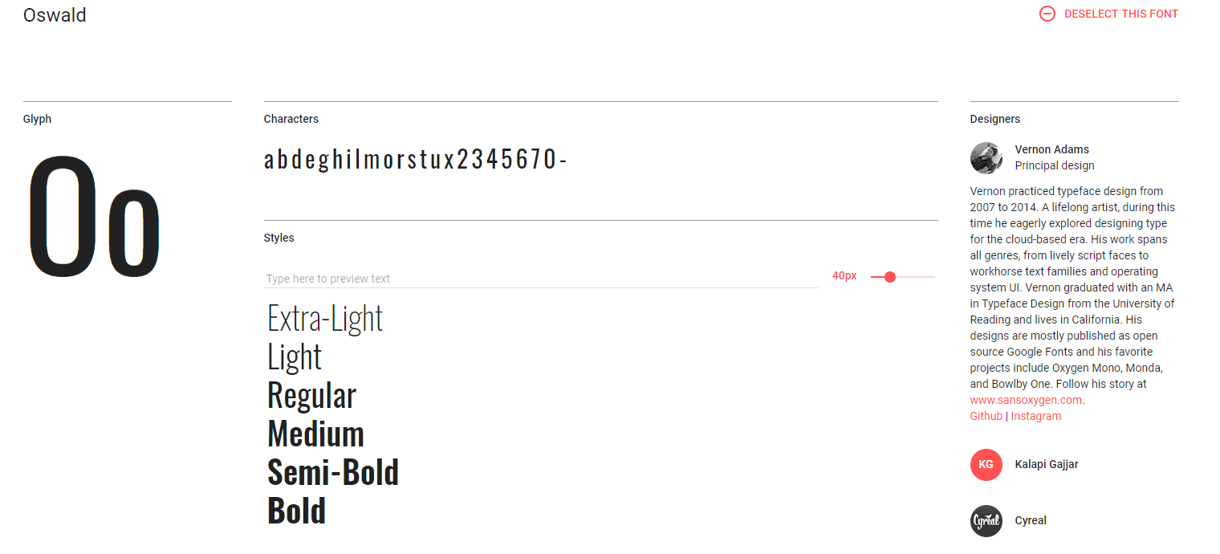
Oswald
<style> @import url('https://fonts.googleapis.com/css?family=Oswald:200,300,400,500,600,700&display=swap'); </style>
font-family: 'Oswald', sans-serif;

Slide 13
Oswald

Slide 14
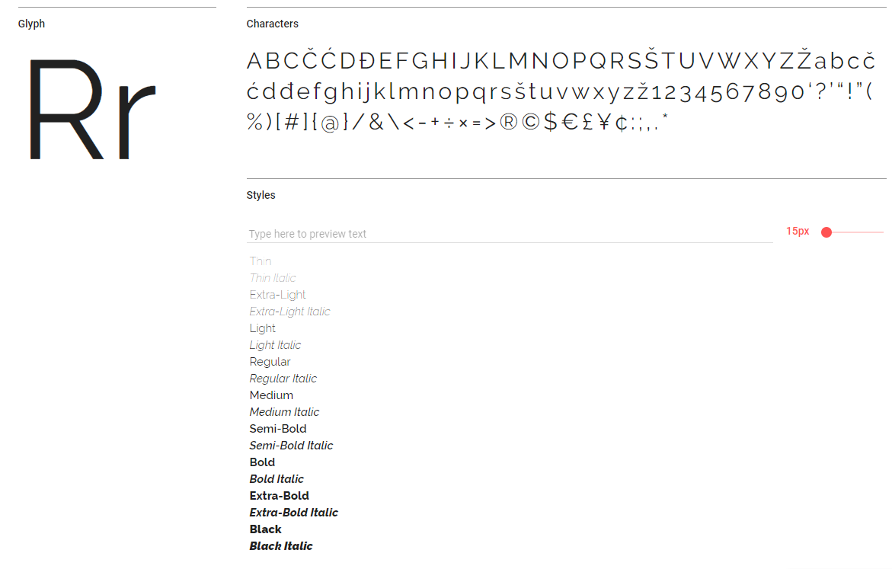
Raleway

Slide 15
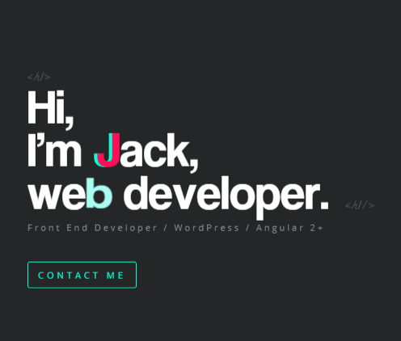
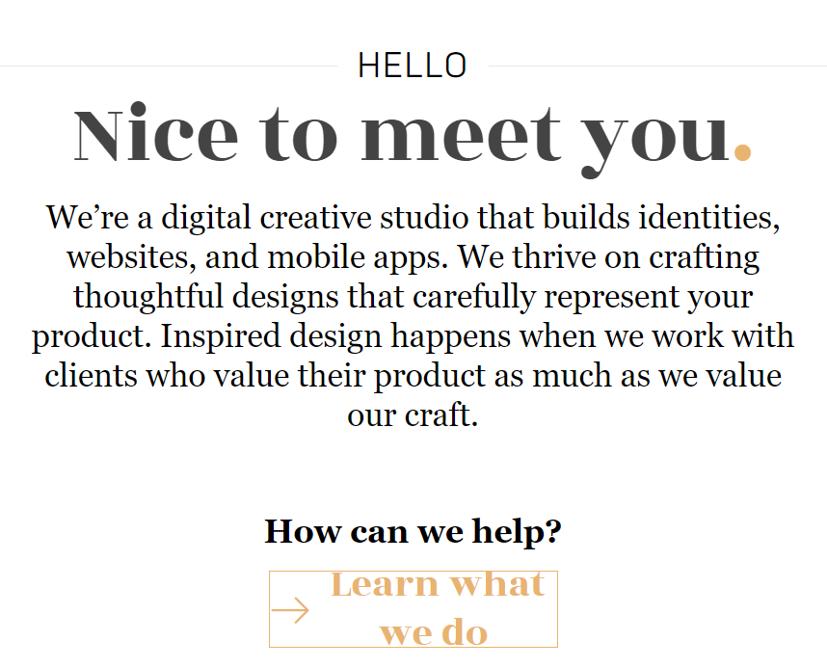
Cinthya Cabanzo
Notes:
HELLO
Nice to meet you.
We’re a digital creative studio that builds identities, websites, and mobile apps. We thrive on crafting thoughtful designs that carefully represent your product. Inspired design happens when we work with clients who value their product as much as we value our craft.

Slide 16
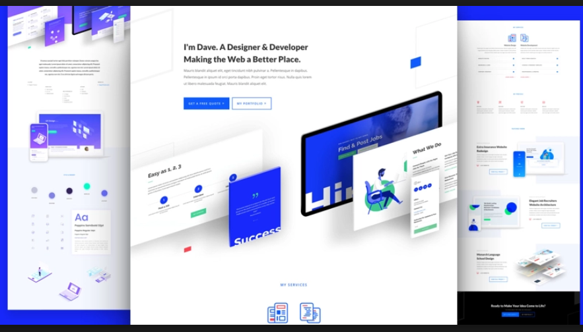
Portafolio

Slide 17
Skills
Notes:
https://jacekjeznach.com/
Identity Design
Web Development
Interface Design

Slide 18
Contacto

Slide 19

Notes:
Photo by Jean-Philippe Delberghe on Unsplash

Slide 20
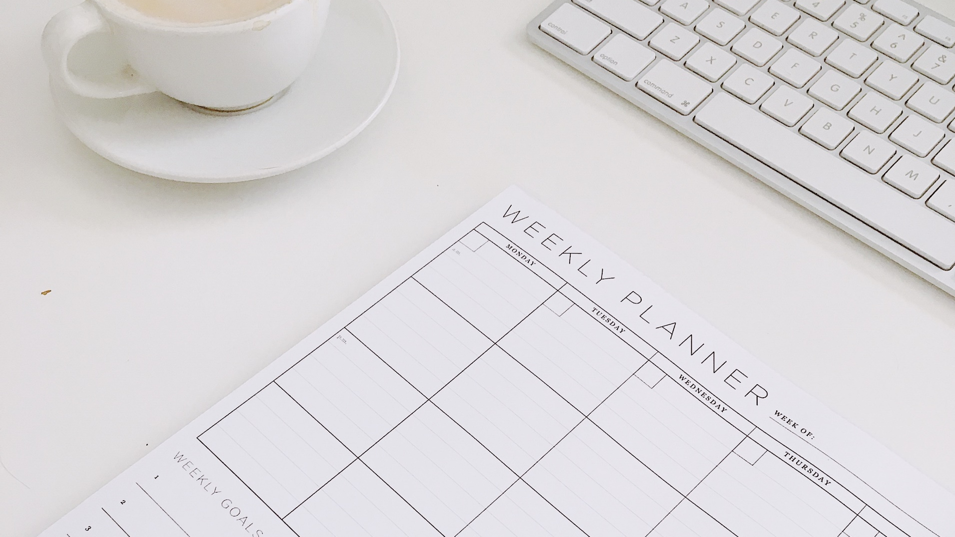
Notes:
Photo by Nikiya Christie on Unsplash

Slide 21

Notes:
Photo by Ellen Qin on Unsplash

Slide 22
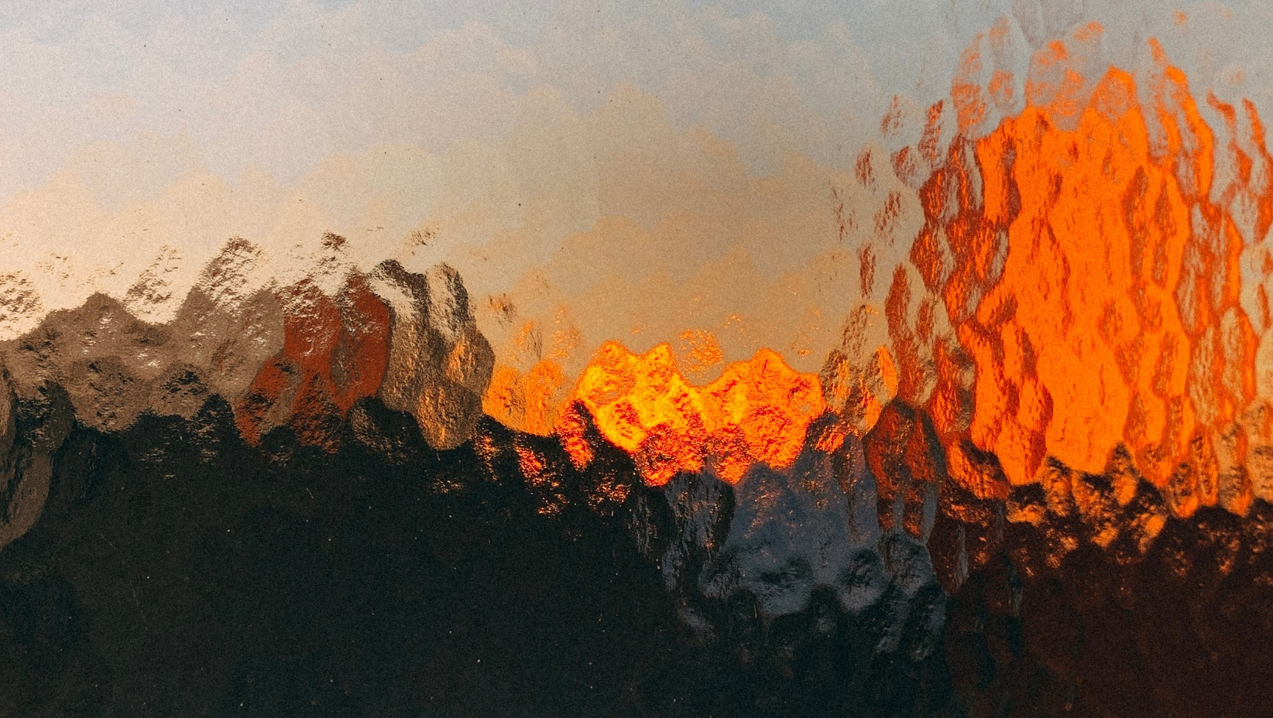
Notes:
Photo by Jonas Denil on Unsplash

Slide 23
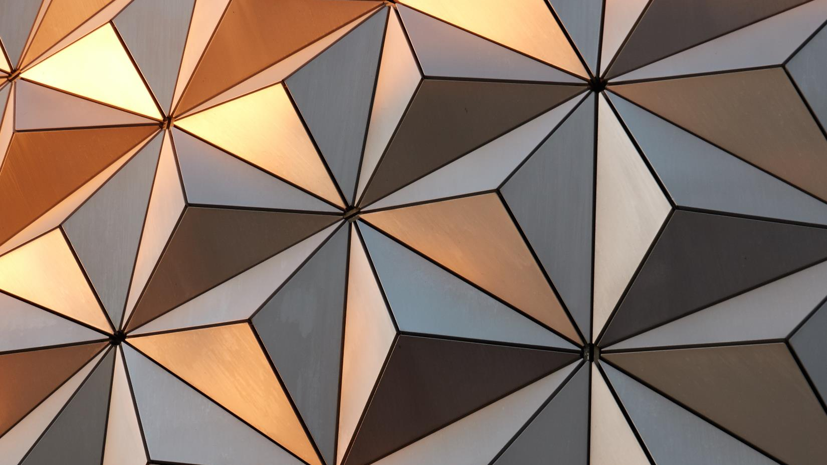

Slide 24

CINTHYA CABANZO
PORTAFOLIO
SKILLS
CONTACTO
Notes:
Photo by Anas Alshanti on Unsplash

Slide 25
CINTHYA CABANZO
PORTAFOLIO
SKILLS
CONTACTO
Notes:
Photo by Anas Alshanti on Unsplash

Slide 26

CINTHYA CABANZO
PORTAFOLIO
SKILLS
CONTACTO
Notes:
Photo by Anas Alshanti on Unsplash

Slide 27

CINTHYA CABANZO
PORTAFOLIO
SKILLS
CONTACTO
Notes:
Photo by Sharon McCutcheon on Unsplash

Slide 28
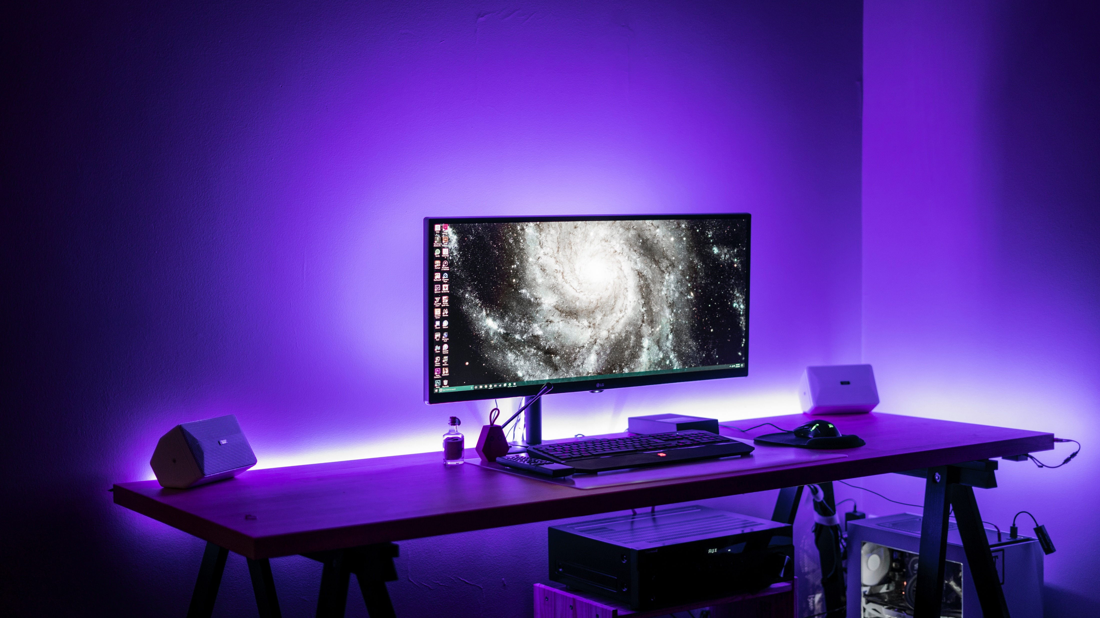
CINTHYA CABANZO
PORTAFOLIO
SKILLS
CONTACTO
Notes:
Photo by Banter Snaps on Unsplash

Slide 29
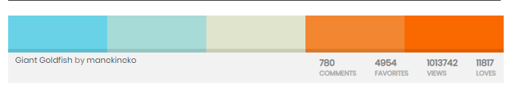
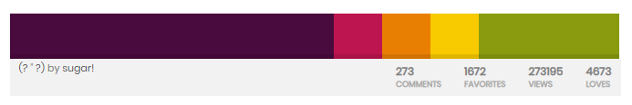
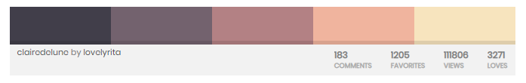
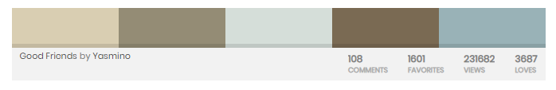
Paletas de colores

Slide 30
Referentes
https://jacekjeznach.com/
Diseño en una sola pagina:
https://www.v76.com/
Iconos flotantes y menú escondido tipo mobile
http://brianhoffdesign.com/#/work/markerly
Objetos 3d con movimiento y el cursor se transforma en un botón de play
https://locomotive.ca/en/projects/spire

Slide 31


Slide 32
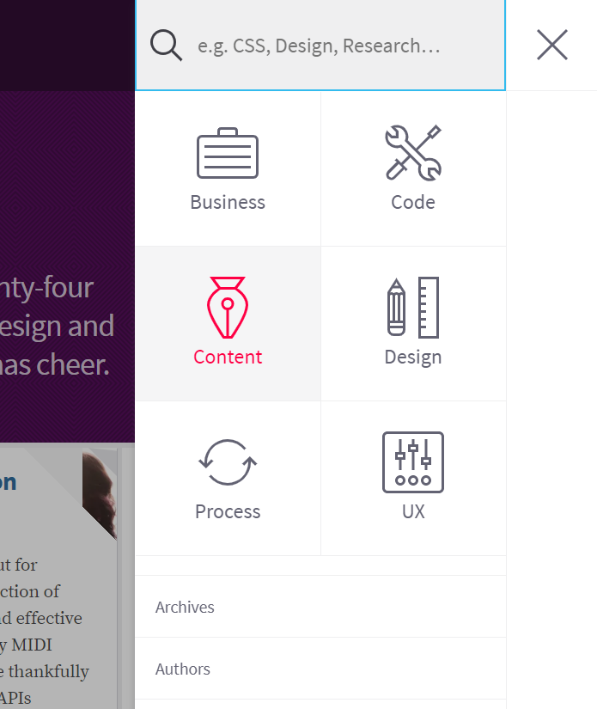
Menu Escondido

